Slide 1
The Teleological Argument
“The entire mystery of the universe is its comprehensibility” (A. Einstein)

Slide 2
A Most Popular Argument…
Like the cosmological argument, it is a posteriori, from effect back to cause.
Argument focuses upon the order, or the means – ends structure of the universe.
The universe reflects a purposive design, a goal or an end, hence the Greek τελοσ.
The argument takes differing forms: the analogical, the anthropic and the intelligent design argument.

Slide 3
The Analogical Argument
An analogy is a comparison between two similar things. If alike in one respect, perhaps another.
William Paley (1743 – 1805) argued that the universe is like a watch, reflecting deign and order, hence, a watchmaker.
He also extended this argument to the shape of the human nose.

Slide 4

The slope allows the rain to drip off very nicely…well planned!

Slide 5
But what if it was inverted?

Slide 6
Then if it rained, we would drown!
So, Paley argued that the shape of our nose was proof positive of purposive intention.
Probably not a clincher argument, but you can grasp his point.
Reality reflects purpose and purpose reflects intelligence.
But let’s not get bogged down looking at noses…

Slide 7

Beauty is almost always the result of deliberate intention. She’s 73 yrs old.

Slide 8

She’s 56 years old.

Slide 9

When intention is absent, the results in general are “aesthetically vile.”

Slide 10
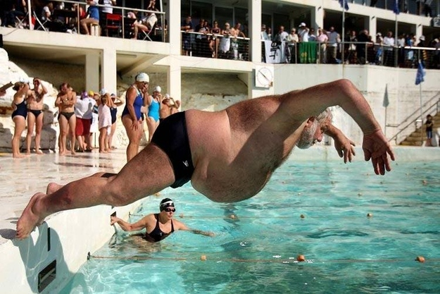
Only in the eye of the beholder?

Slide 11

Such obvious beauty and intelligible order is the result of design.

Slide 12

But we’re stuck on this planet, so of course, we find it beautiful.

Slide 13
Try the Anthropic Argument
The universe is uniquely ordered to serve the purposes of life, specifically human life.
This state of affairs is highly improbable and argues for an intelligence that purposively designed life to be the goal of creation.
Unusual or improbable design argues strongly on behalf of a conscious designer.

Slide 14
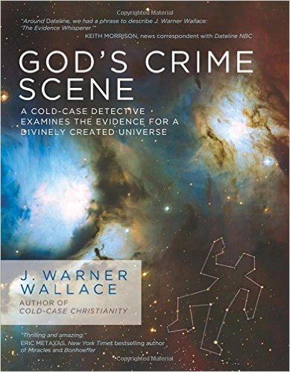
God’s Crime Scene by J. Warner Wallace’s

Slide 15
The Homicide Crime Scene
Every homicide begins as a simple death investigation.
When a dead body is discovered, detectives must investigate the evidence to determine the most reasonable explanation.
Did the deceased die 1) naturally, 2) by accident, 3) by suicide, or 4) by murder?
These are the only four (4) explanations possible at any death scene.

Slide 16
Richard is found dead…
Richard was recently diagnosed with liver cancer and his daughter stopped by when he didn’t answer his phone for a few days.
He is found lying on the floor of his livingroom with both arms outstretched, a gunshot entry wound under his chin and his skull was blown open.
His legs were straight, swollen and discolored.
A handgun lay on the floor near him as the TV blared in the background.

Slide 17
Evidence for Consideration
A gun is found inside the room that does not belong to the victim.
There is mud on the floor from a shoe foreign to the victim’s house.
There are fingerprints in the room that belong to someone other than the victim.
There is DNA in the room that belongs to someone other than the victim.

Slide 18
More evidence to consider…
The wound under the chin is the left side of the neck, but Richard is right-handed.
The gun is on the left side of the body, but Richard is right-handed.
There is no suicide note and Richard never owned a handgun.
The TV is on, but is also on record. Who records a show when they are going to kill themselves?
The dirt and shoe prints are from someone other than Richard.
Shoeprints by the garden window looking into the living room match those found in the living room.

Slide 19
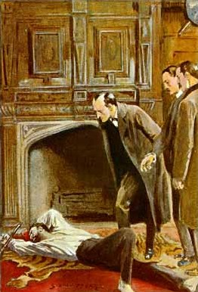
Suicide? or Murder?

Slide 20
Think of the Universe as a ‘room.’
Look at the evidence in the ‘room’ carefully.
Can it all be explained fully by the characteristics of the room?
Is there any evidence inside the universe pointing to the existence of a supernatural being outside the universe?
Can I account for all the evidence inside the room by staying in the room?

Slide 21
God’s Crime Scene
Origination of evidence…”How long has this item been at the scene?”
Causation of evidence…”Who or what caused this evidence to appear at the scene?”
Explanation of evidence…”Why did the evidence appear at the scene and what does this tell us about the suspect?”

Slide 22
Foundational Fine—Tuning
The constants and proportions of the strong nuclear force, weak nuclear force, the force of gravity and the electromagnetic force must exist within very narrow ranges in order for life to exist in the universe.
The ratio of electrons to protons, both in their number and in their mass, must be precariously balanced.
If it deviates more than 1 in 10³⁷ the universe as we know it would not exist today.
If the ratio between the electromagnetic force and gravity was altered more than 1 in 10⁴⁰ the universe would suffer a similar fate.

Slide 23
Pretty finely tuned…
If gravity was stronger/weaker the universe would not have formed as it did to support life.
If the density of the universe was higher by even a minuscule amount, everything would have collapsed into a black hole.
Atomic particles have exactly the numerical properties needed to form the elements of life, carbon and oxygen.

Slide 24
Or what about Intelligent Design…
Irreducible complexity of living organisms cannot be explained by random processes.
Specified complexity is a key sign of intelligence, such as a long sequence of prime numbers.
DNA has hundreds of protein molecules that reflect specified complexity.
And their arrangement produces a living organism that flourishes.

Slide 25
Chances are…remote!
It would take longer than the universe has been in existence to occur by chance operating randomly over time.
The molecules have to be brought together in a specific sequence to achieve a specific goal.
The best explanation for such specific complexity is an intelligent being produced it.
Or else, we are really, really, lucky!

Slide 26

Las Vegas would arrest you!

Slide 27
A run of improbabilities…
Nature is not the result of just one (1) lucky chance, but of countless lucky chances.
Such a run of countless improbable occurrences needs an explanation, no?
The intelligible order of our world is the sort of world that a mind might fittingly propose to itself as an end.

Slide 28
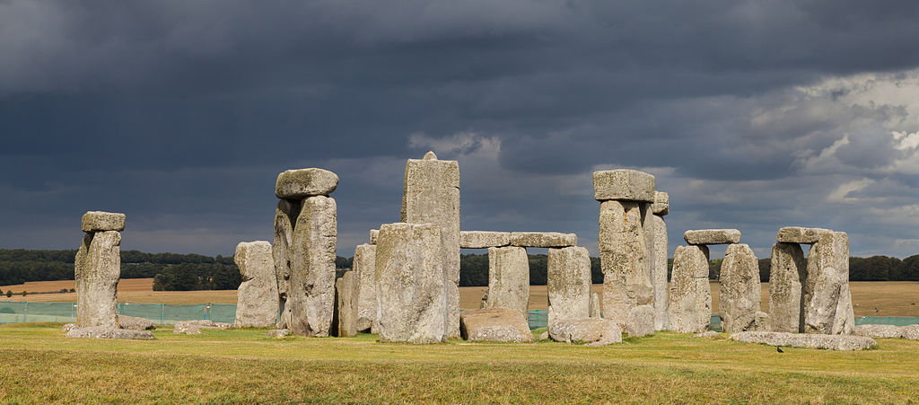
What about Stonehenge?

Slide 29
3,000 – 2,000 BC
A prehistoric burial site to be sure…
But the stones are aligned to the winter and summer solstice, suggesting a higher purpose.
Whatever religious, mystical or spiritual elements were central to Stonehenge, its design includes a celestial observatory function, which might have allowed prediction of eclipse, solstice, equinox and other celestial events important to a contemporary religion.

Slide 30
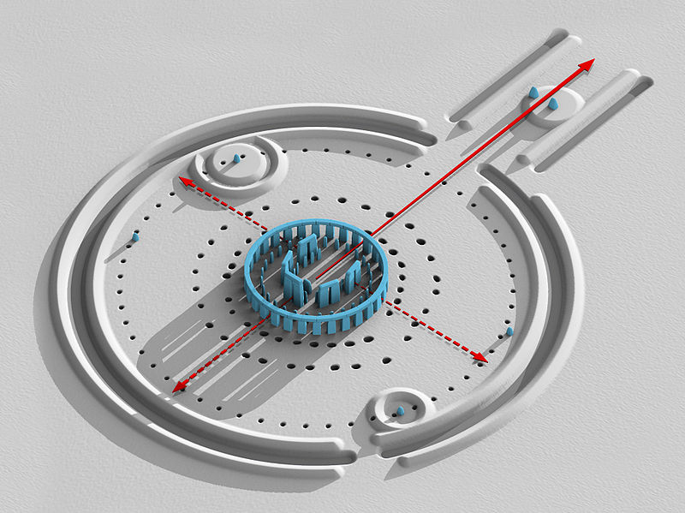
Purposive? Random?

Slide 31
A divinized universe…
The default non-theistic response is that the universe itself does all this more or less automatically.
The universe creates life all by itself, the universe self organizes this life, the universe takes care of everything.
Of course, when you invest the universe with godlike powers, who needs God?
Divinize the universe, and the problems’ solved.

